Slide 1
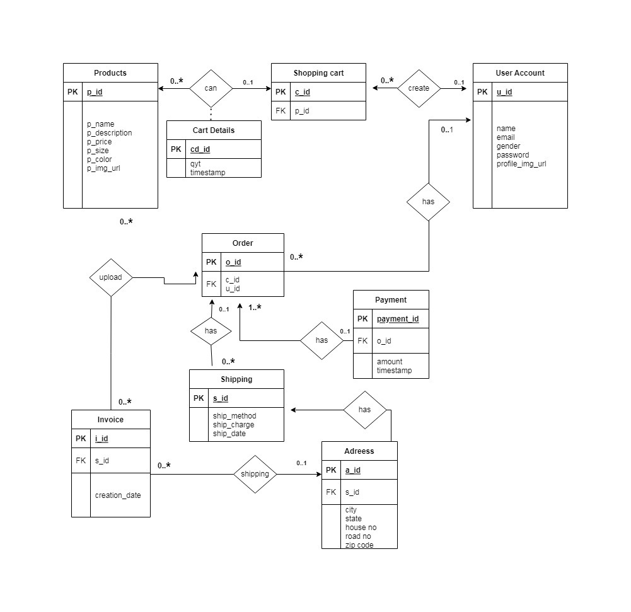
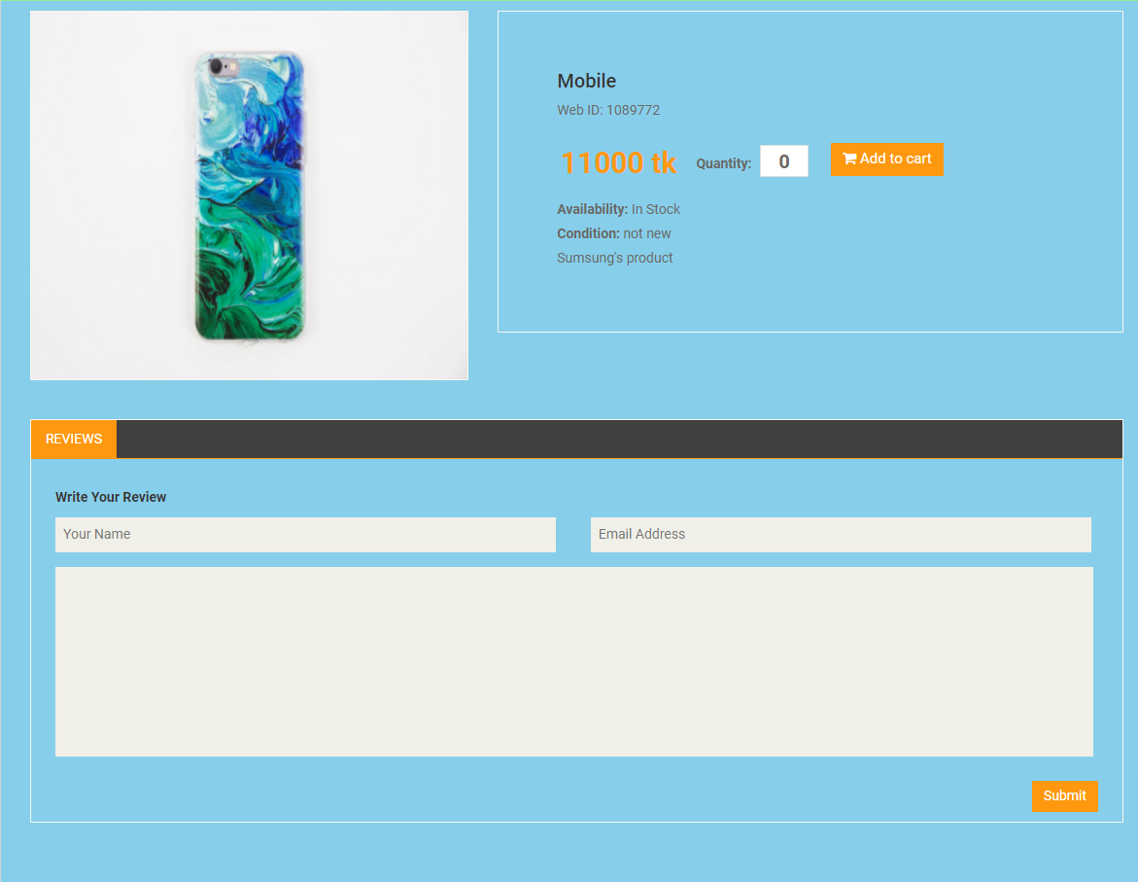
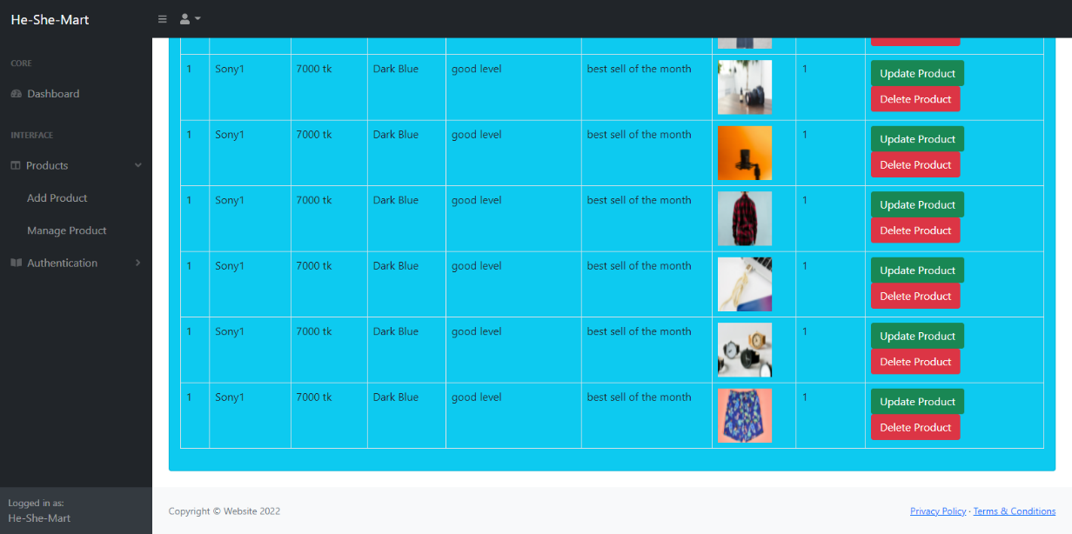
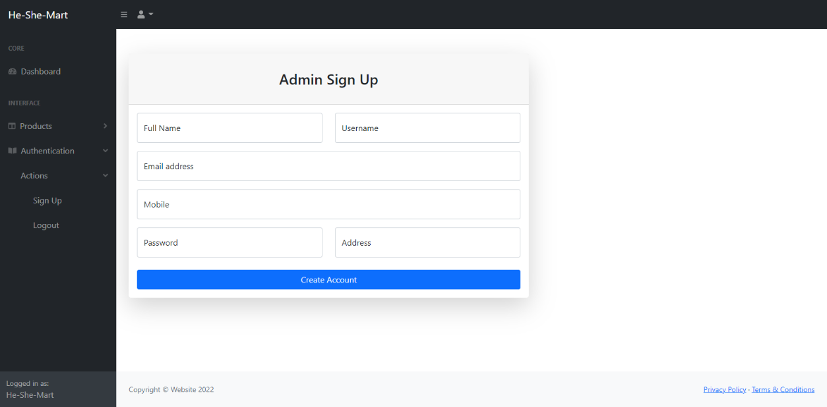
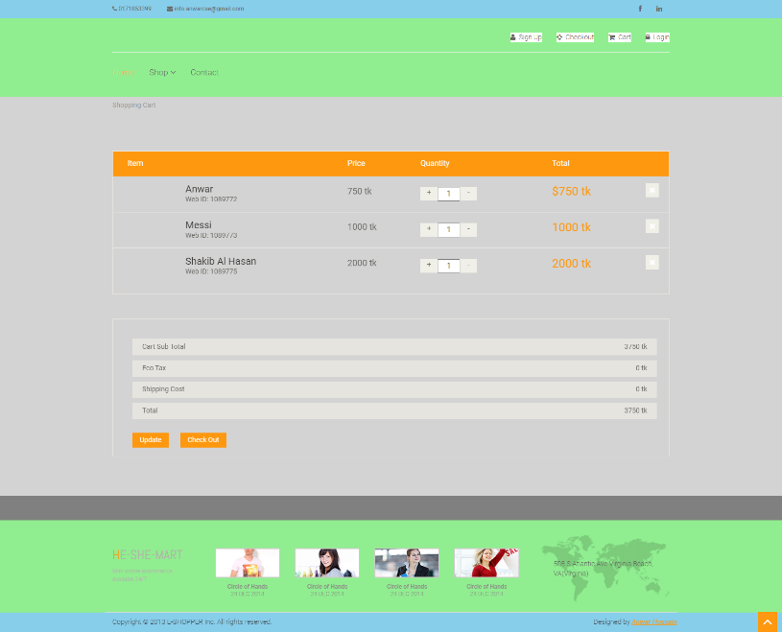
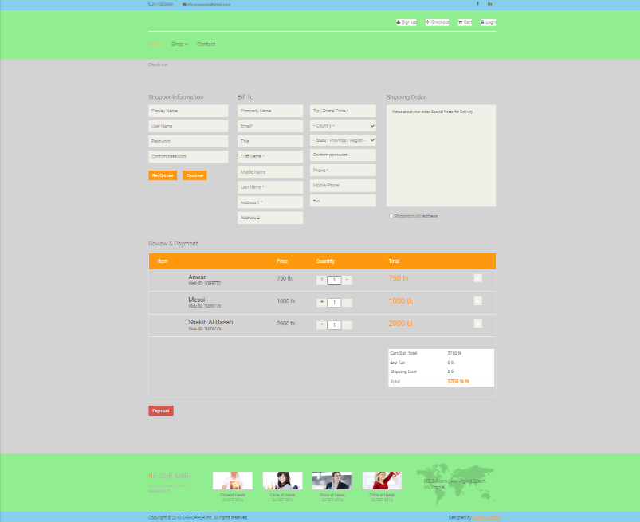
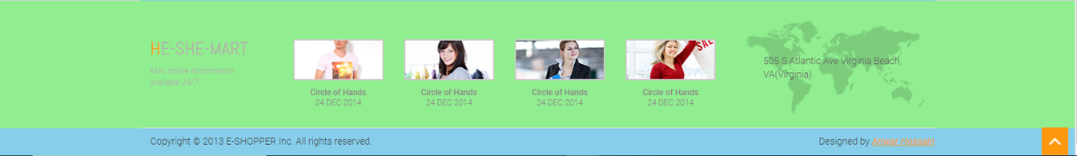
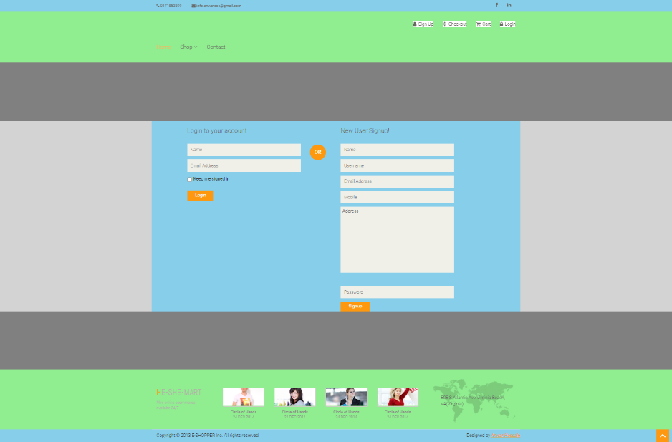
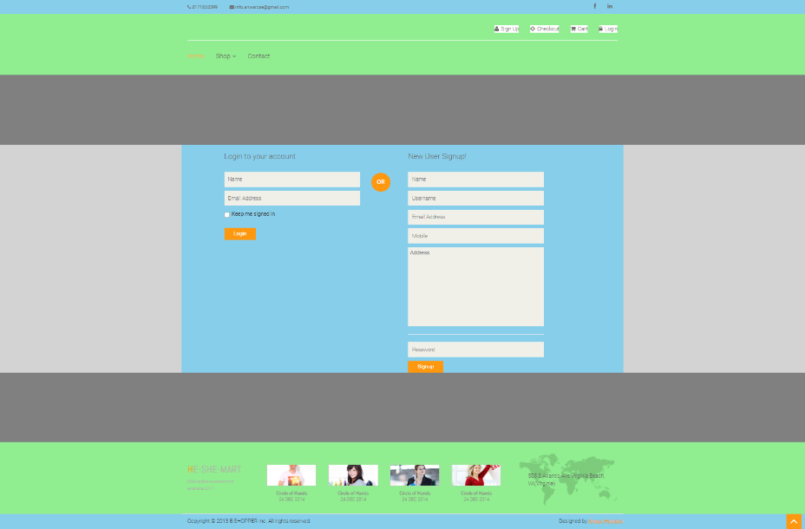
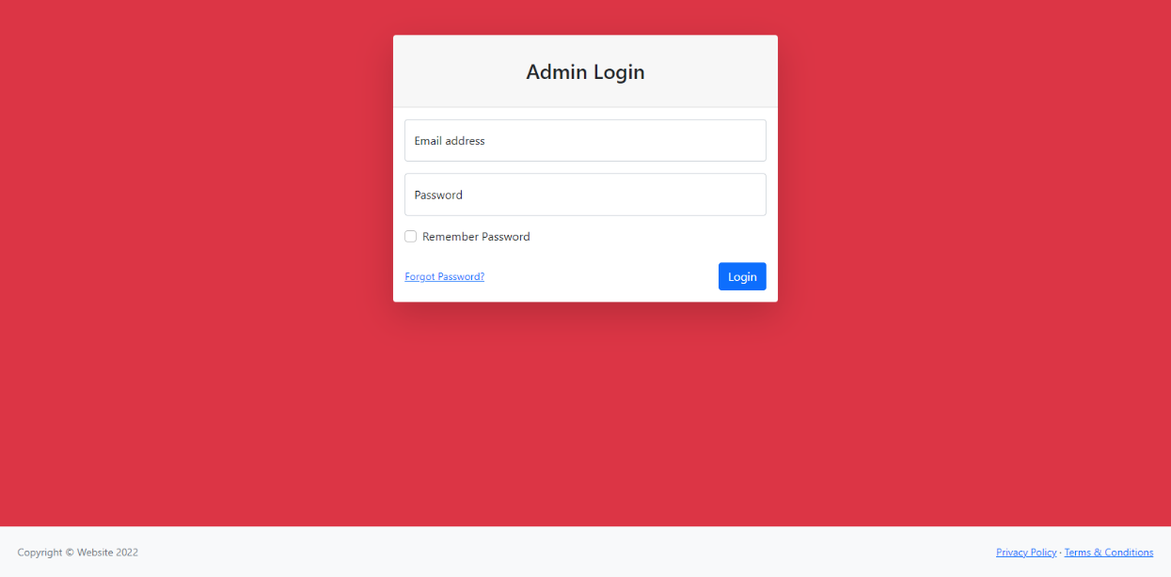
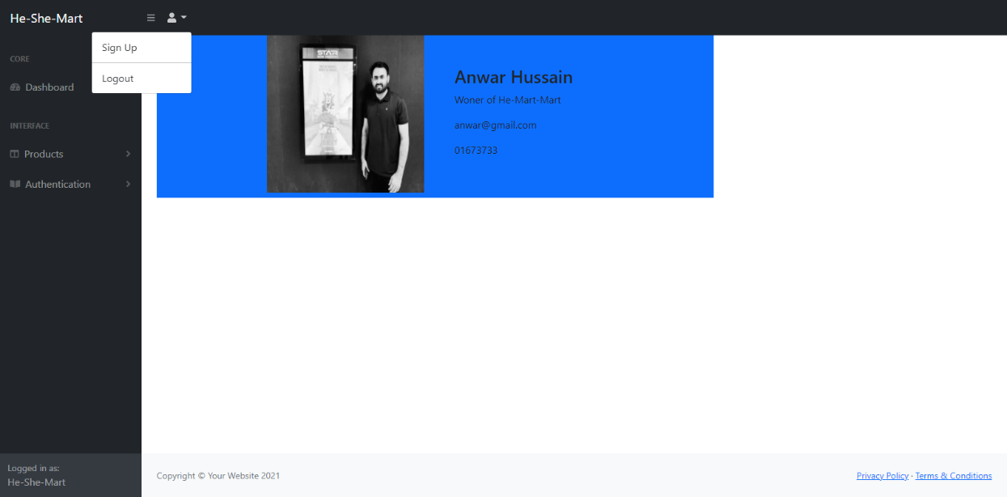
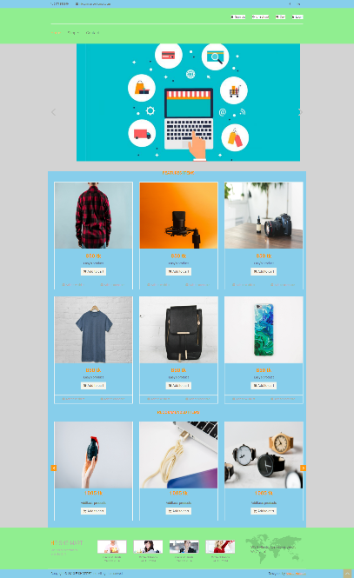
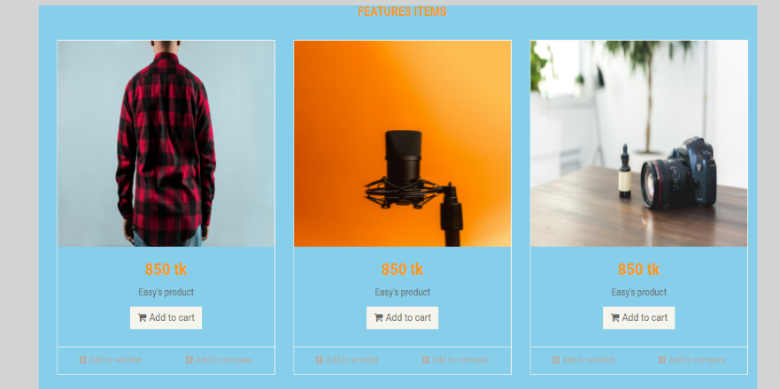
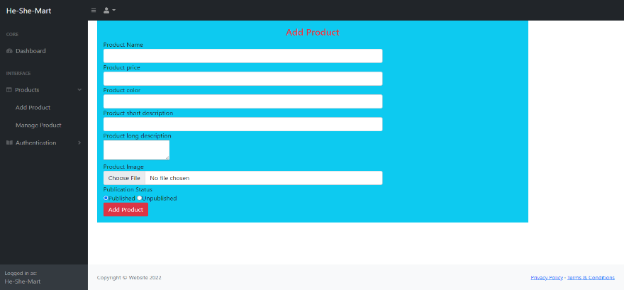
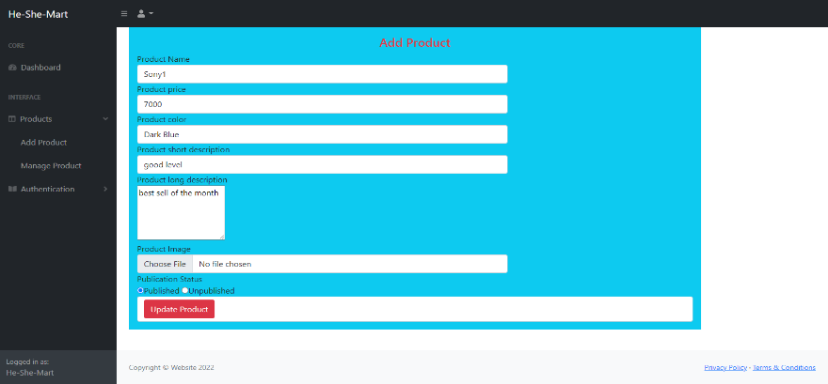

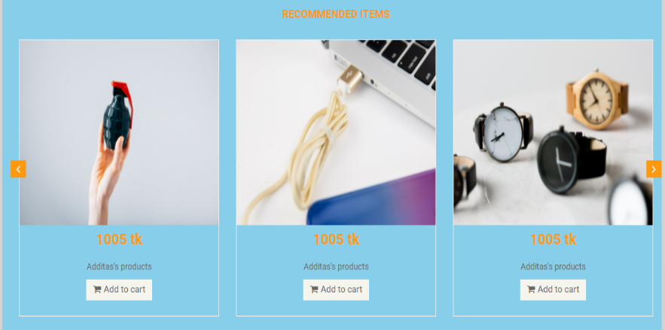
He & She Mart (For CSE-402 at 2/2/2022)
Anwar Hossain(170303020102-info.anwarcse@gmail.com) (Supervisor:PS)
Major Features:
Basic CRUD functionality.
Daraz like-show products, product prize, details, add to cart
Recommended items show
Basic cart functionality
Daraz like- checkout functionality
Details of specific products
Feedback or any query user can directly or by using contact form
An admin can upload product, update products, edit products
Admin can add new admin
Responsive CSS
ER Diagram:
Products Details
Managing Products
Add new admin
Cart
Completed works:
100% frontend and backend
Contribution:
All of work done by me
Unit testing, browser testing I completed
I understand every single line of code there is in the project. And I ready to answer any question about the whole project.
Checkout
Tools and Technologies:
HTML5, CSS3 for designing website
Bootstrap for responsive CSS.
JavaScript for user interaction
Develop the back end using laravel framework( including raw PHP)
Have done template mastering by using third party template for backend and frontend in laravel
MySQL using for handling database
Feature: Basic CRUD Functionality
Feature: Home Page
Footer
Signup page
Sign in page
Feature: Admin Panel
Admin login
Dashboard
Home page
Products
Add products
Update Products
Header
Recommended Products

